Slide 1
Eigenvalues, networks,
and shapes
(or: a few “different” things that are actually just linear algebra!)

Slide 2
A brief roadmap for our conversation:
What does “network” (or “graph”) mean?
Where do we see graphs, and why are they important?
What does this have to do with linear algebra?
Eigenanalysis shows us clusters in graphs!
What if my data is shaped into something more complex than clusters?

Slide 3
A “network” or “graph” is a model of communication
A network models how different things “talk” to one another
Networks are modeled by objects called graphs
Graphs have a simple mathematical structure:
A vertex set, also sometimes called “nodes” -- our objects of interest
A set of edges, the “lines of communication” between vertices
G = (V,E)

Slide 4
We can build very different graphs on the same vertex set!
G₀ = (V,E₀)
G₁ = (V,E₁)
G₂ = (V,E₂)
G₃ = (V,E₃)
G₄ = (V,E₄)
G₅ = (V,E₅)
G₆ = (V,E₆)
G₇ = (V,E₇)
G₈ = (V,E₈)
G₉ = (V,E₉)
A puzzle: How many non-equivalent connected graphs on 5 vertices exist?

Slide 5
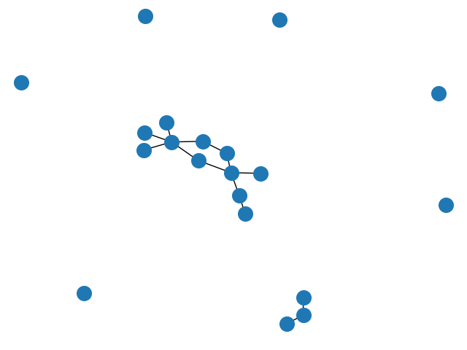
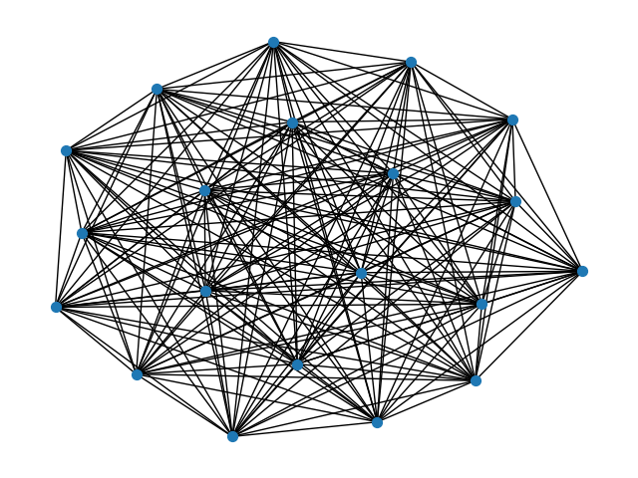
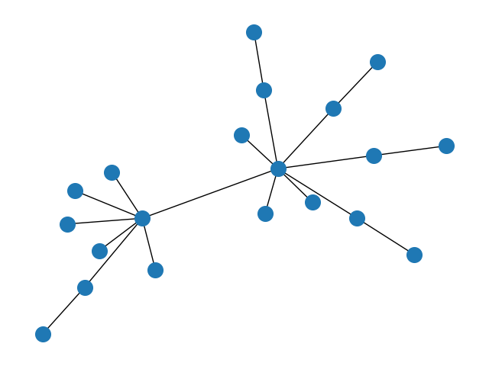
Graphs can neatly describe complicated data properties
Graphs can be “connected” ( ) or “disconnected” ( )
Graphs can be “sparse” ( ) or “dense” ( )
Graphs also often have clusters! (also called “communities”)
How many communities?
What are their relative sizes?
How do we find them if we have thousands/millions of vertices?
These properties often carry very interpretable information!
how many communities would you say this graph has? why?

Slide 6
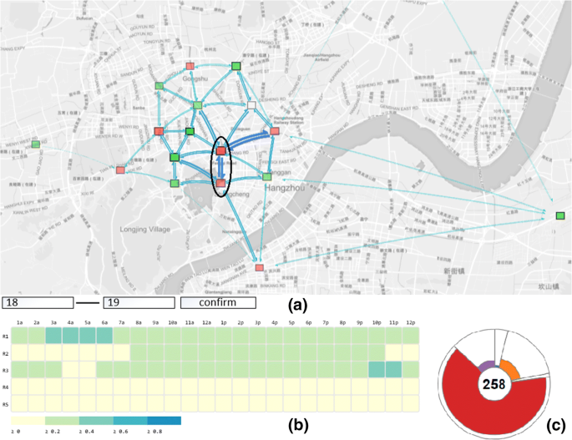
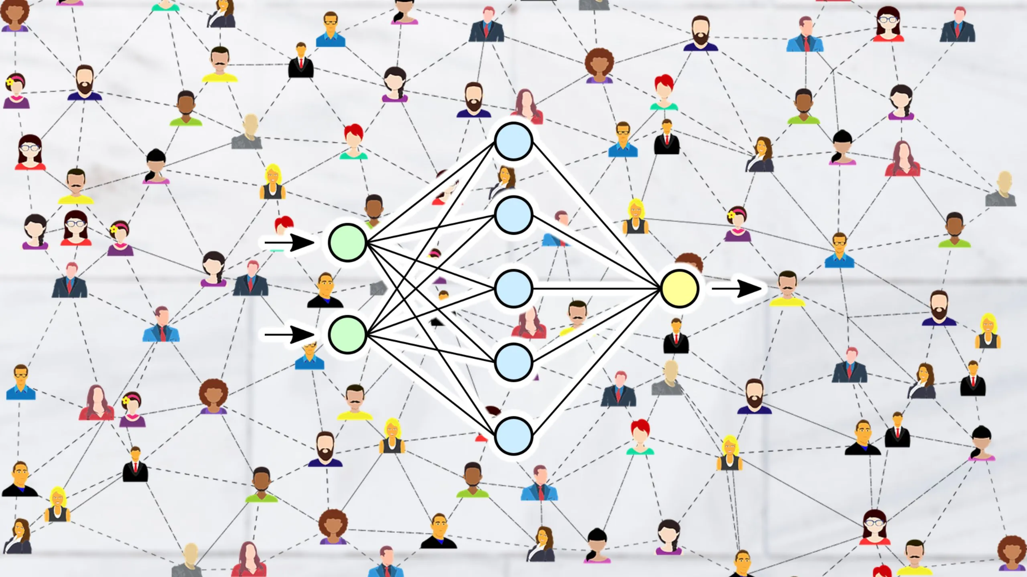
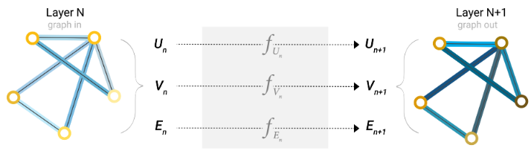
Graphs (or networks) get used all the time!
[1] L. Liu, H. Zhan, J. Liu, and J. Man, “Visual analysis of traffic data via spatio-temporal graphs and interactive topic modeling,” J Vis, vol. 22, no. 1, pp. 141–160, Feb. 2019, doi: 10.1007/s12650-018-0517-z.
Traffic analysis:
Graph Neural Nets: https://distill.pub/2021/gnn-intro/
Social networks

Slide 7
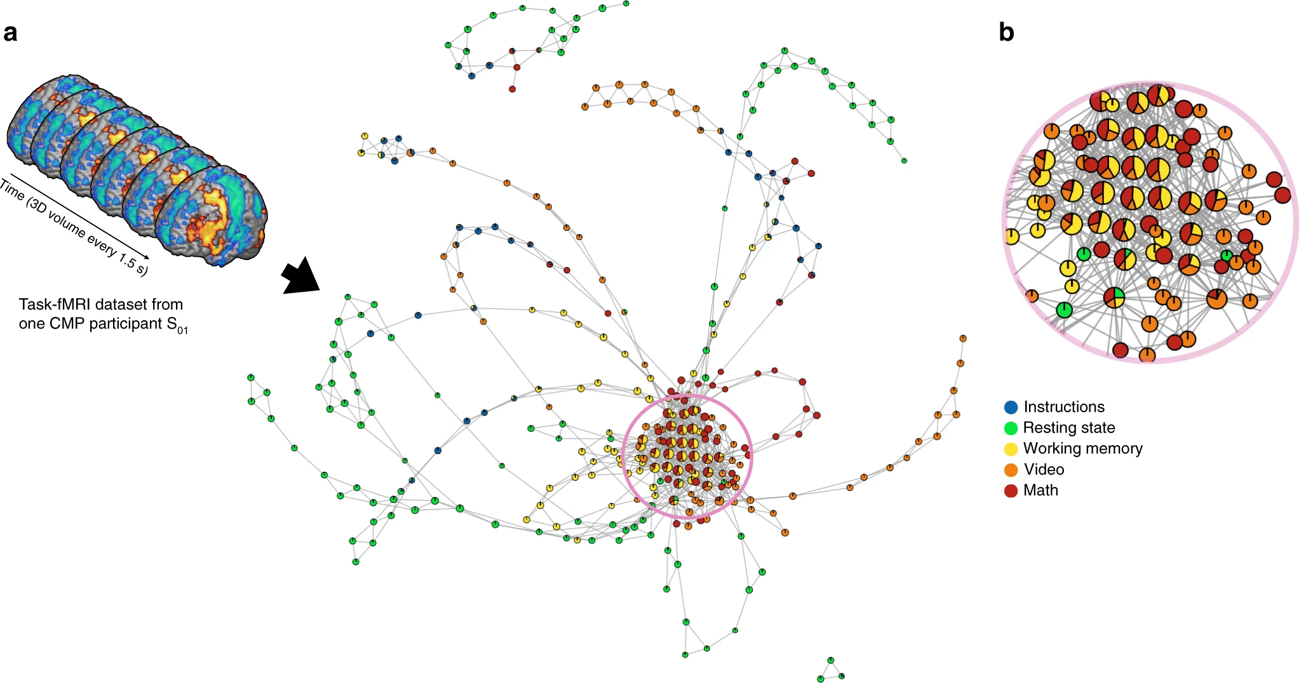
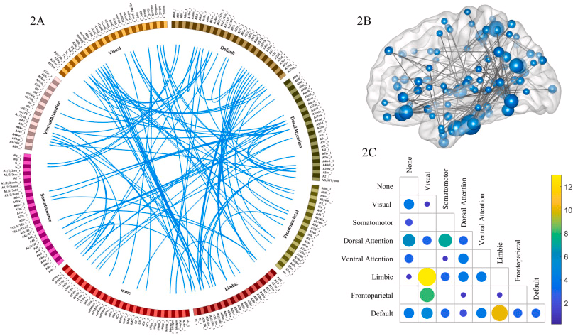
Our motivating network example: Brains!
[1] P. Liu et al., “The functional connectome predicts feeling of stress on regular days and during the COVID-19 pandemic,” Neurobiology of Stress, Volume 14, May 2021, 100285, doi: 10.1016/j.ynstr.2020.100285.
[2] M. Saggar et al., “Towards a new approach to reveal dynamical organization of the brain using topological data analysis,” Nature Communications, vol. 9, no. 1, pp. 1–14, Dec. 2018, doi: 10.1038/s41467-018-03664-4.

Slide 8
…but how is this related to
Linear Algebra?

Slide 9
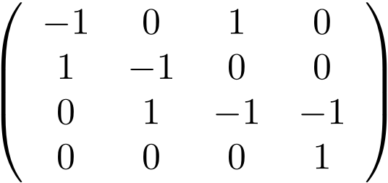
Graph computations are all done with linear algebra!
A graph can be specified by an “incidence matrix,” where we record the endpoints of each edge:
Edge basis
Incidence
Matrix
Vertex basis
G = (V,E)
S ~ |V|✕|E| matrix

Slide 10
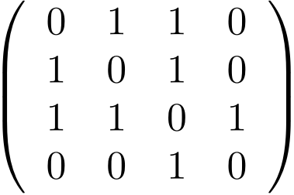
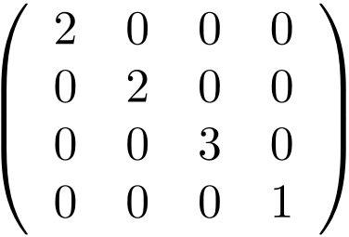
Graph computations are all done with linear algebra!
Vertex basis
A graph can also be specified by its adjacency matrix, where we record which vertices are connected by an edge:
Vertex basis
Adjacency
Matrix
D∊R^{|V|}
(as diagonal)
A ~ |V|✕|V| matrix
G = (V,E)
2
2
It’s often useful to also record the degree matrix, the number of edges at each vertex: the degree matrix is just the sum of the rows (or columns) in A.
3
1

Slide 11
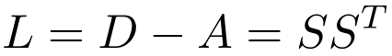
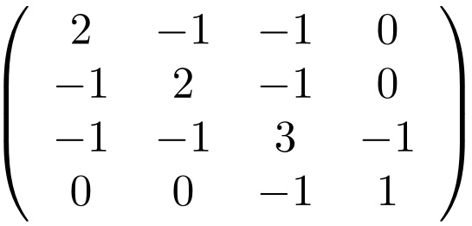
Solving the clustering problem: the graph Laplacian
We need one more definition before we’re ready to attempt the graph clustering problem: the graph Laplacian L
S is the incidence matrix
A is the adjacency matrix
D is the degree matrix
Graph
Laplacian

Slide 12
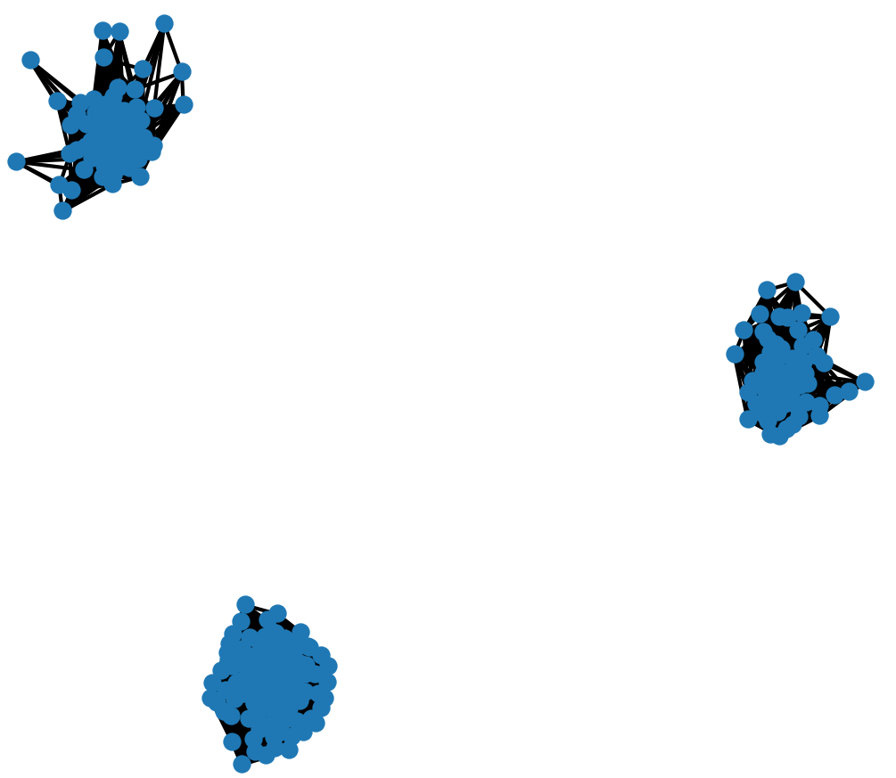
Solving the clustering problem: the graph Laplacian
Eigenvector and eigenvalue properties of graph Laplacian
Rank of graph Laplacian is n-k, where k is number of connected components (and n=|V|)
Having k very strong clusters means eigenvalue 0 has multiplicity k (see example)
Does this help us solve the clustering problem? Can we think of clusters/communities as being “almost disconnected?”

Slide 13
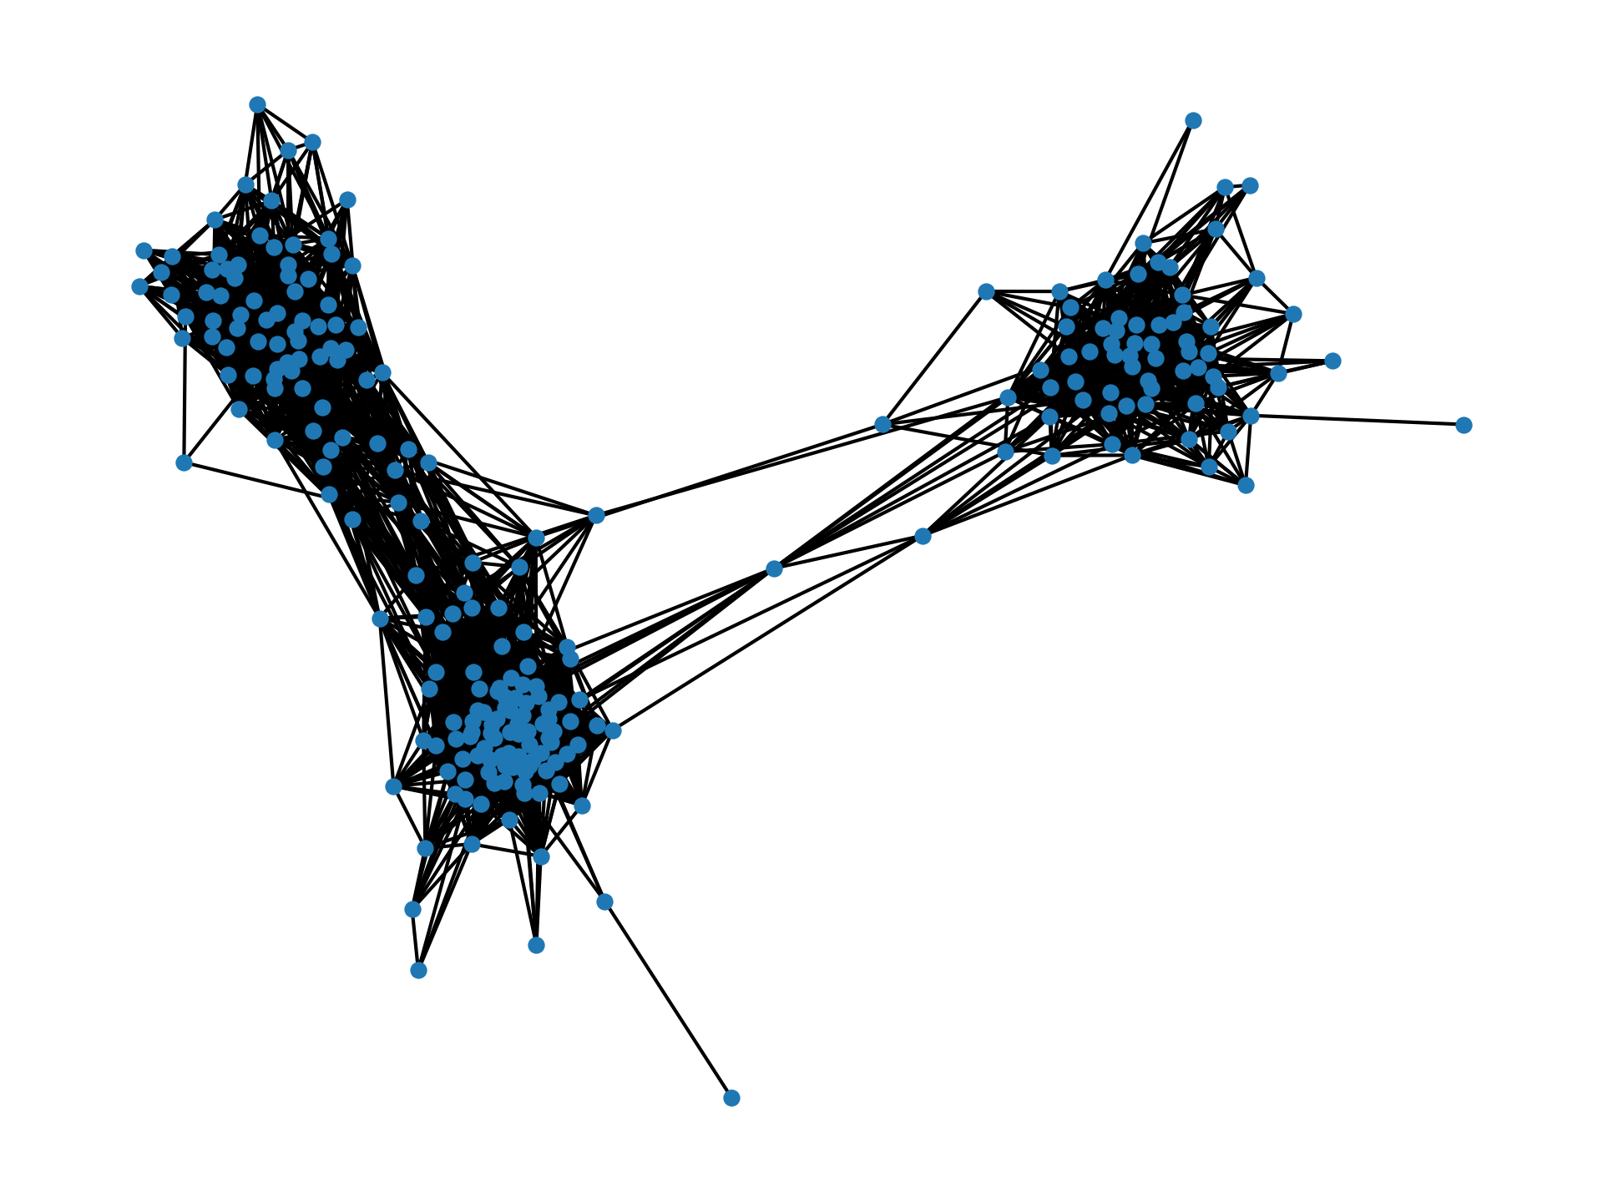
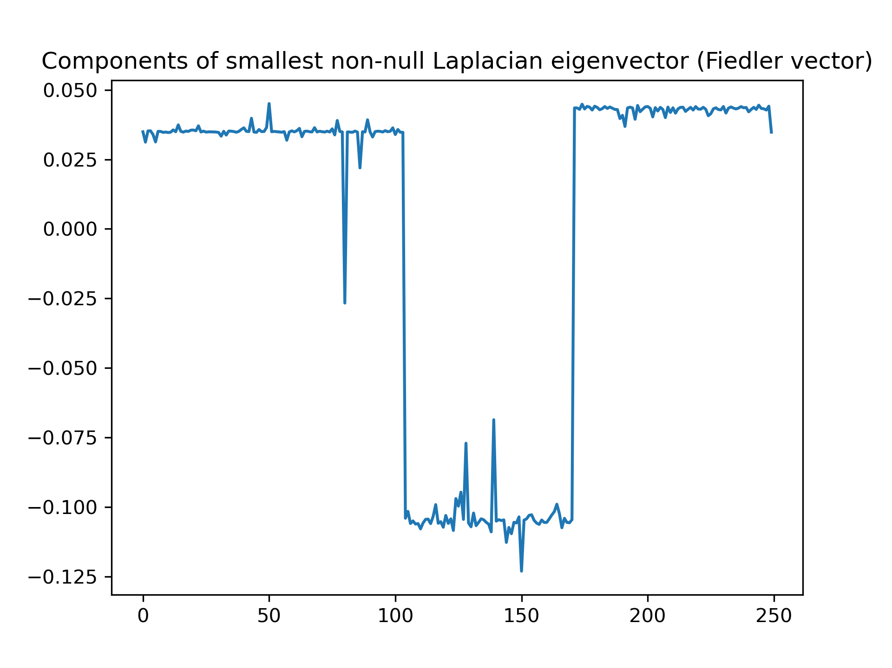
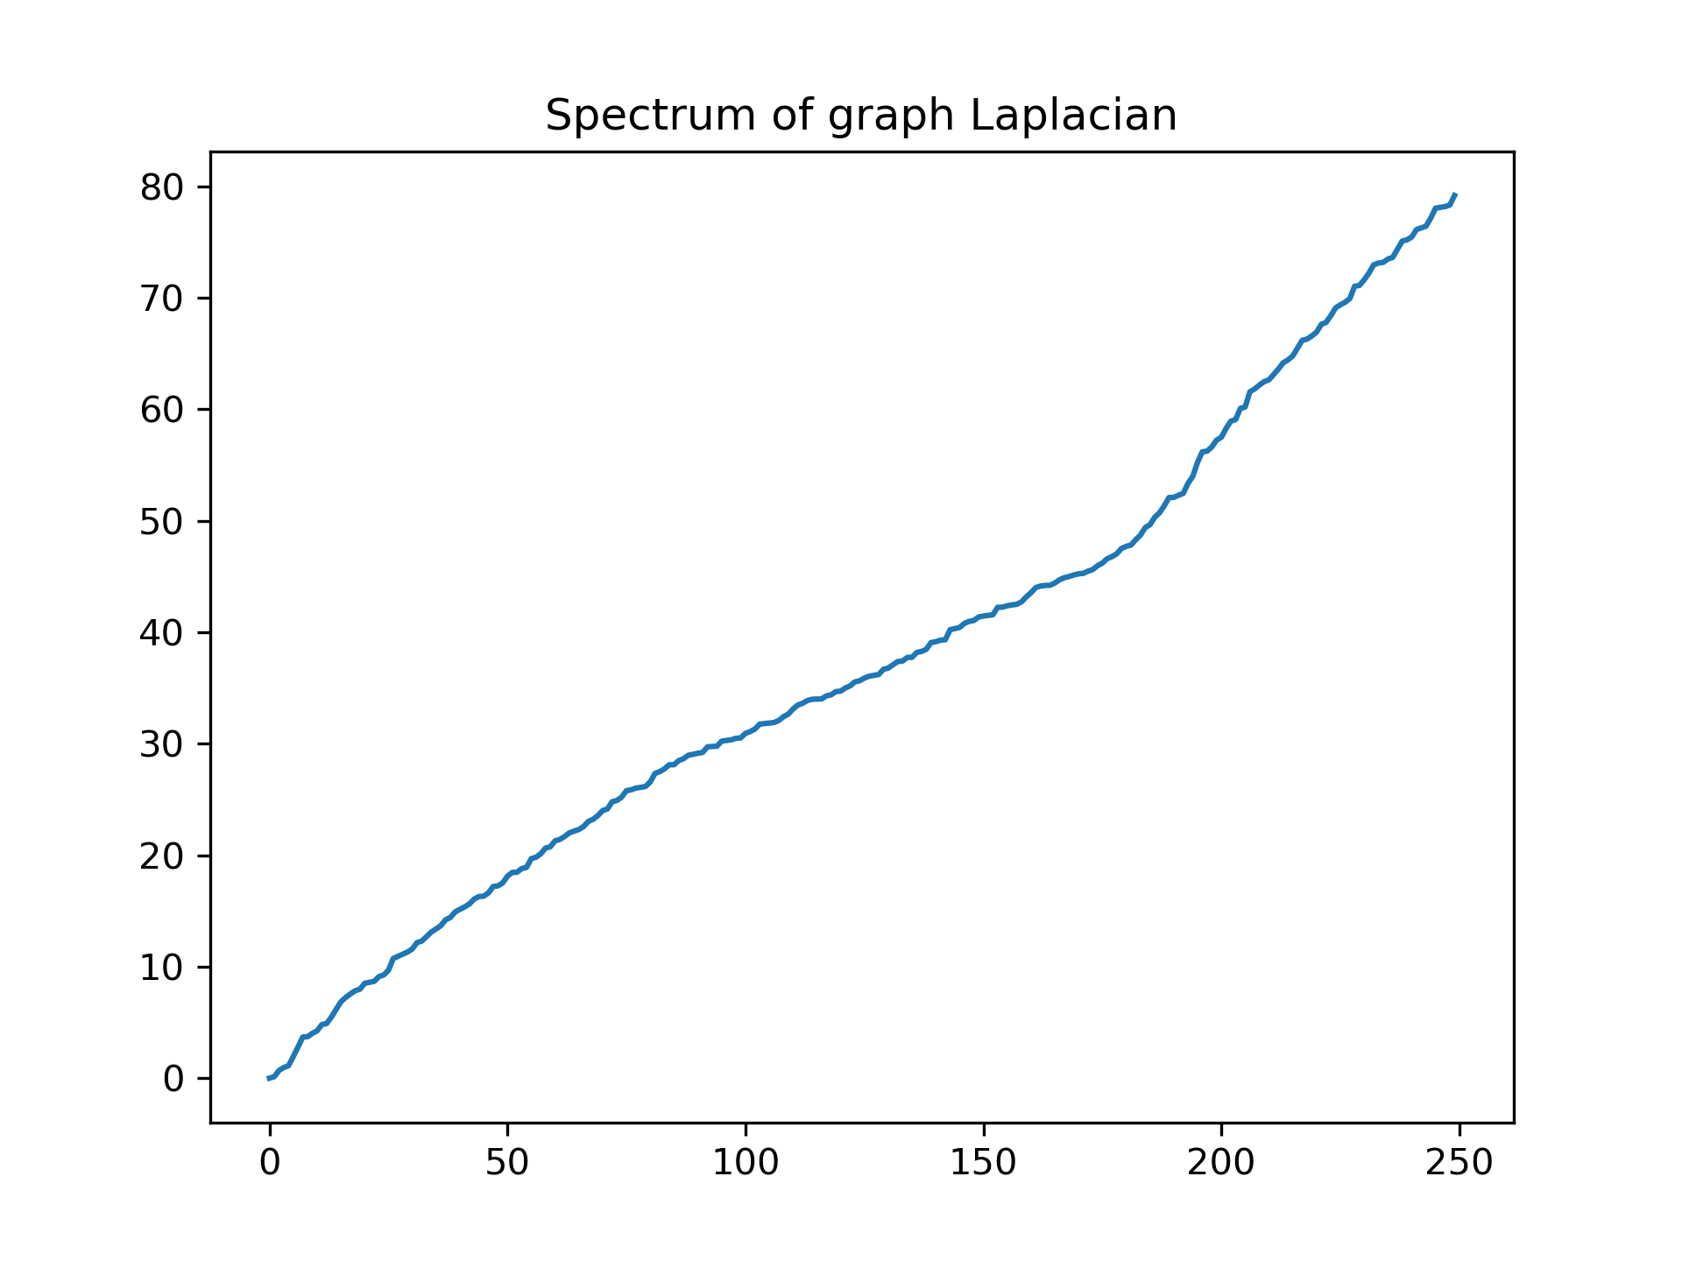
Solving the clustering problem: the graph Laplacian
In practice, clusters are rarely so distinct:
First non-null eigenvector shows three (3) clusters!
Multiplicity of 0 eigenvalue doesn’t help :(

Slide 14
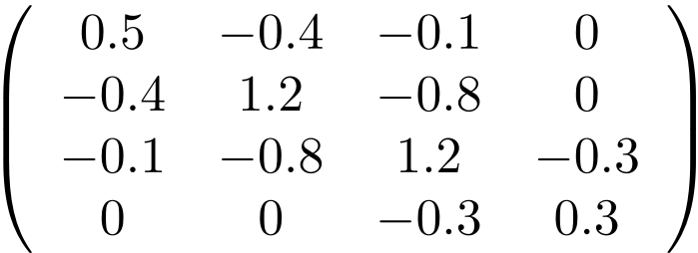
The graph Laplacian in practice -- graphs with weights
Often, our edges have “weights” instead of being binary:
→changes values (but not definition) of adjacency/degree matrix
→changes values (but not definition) of graph Laplacian
0.1
Graph
0.3
0.4
Laplacian
0.8

Slide 15
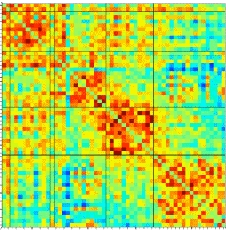
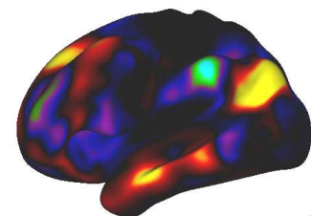
The graph Laplacian in practice -- graphs with weights
Functional MRI data have a natural weighted graph structure!
Brain locations form vertices
All possible edges exist
Vertices with more similar signals have larger edge weights
Adjacency Matrix
Vertex Set

Slide 16
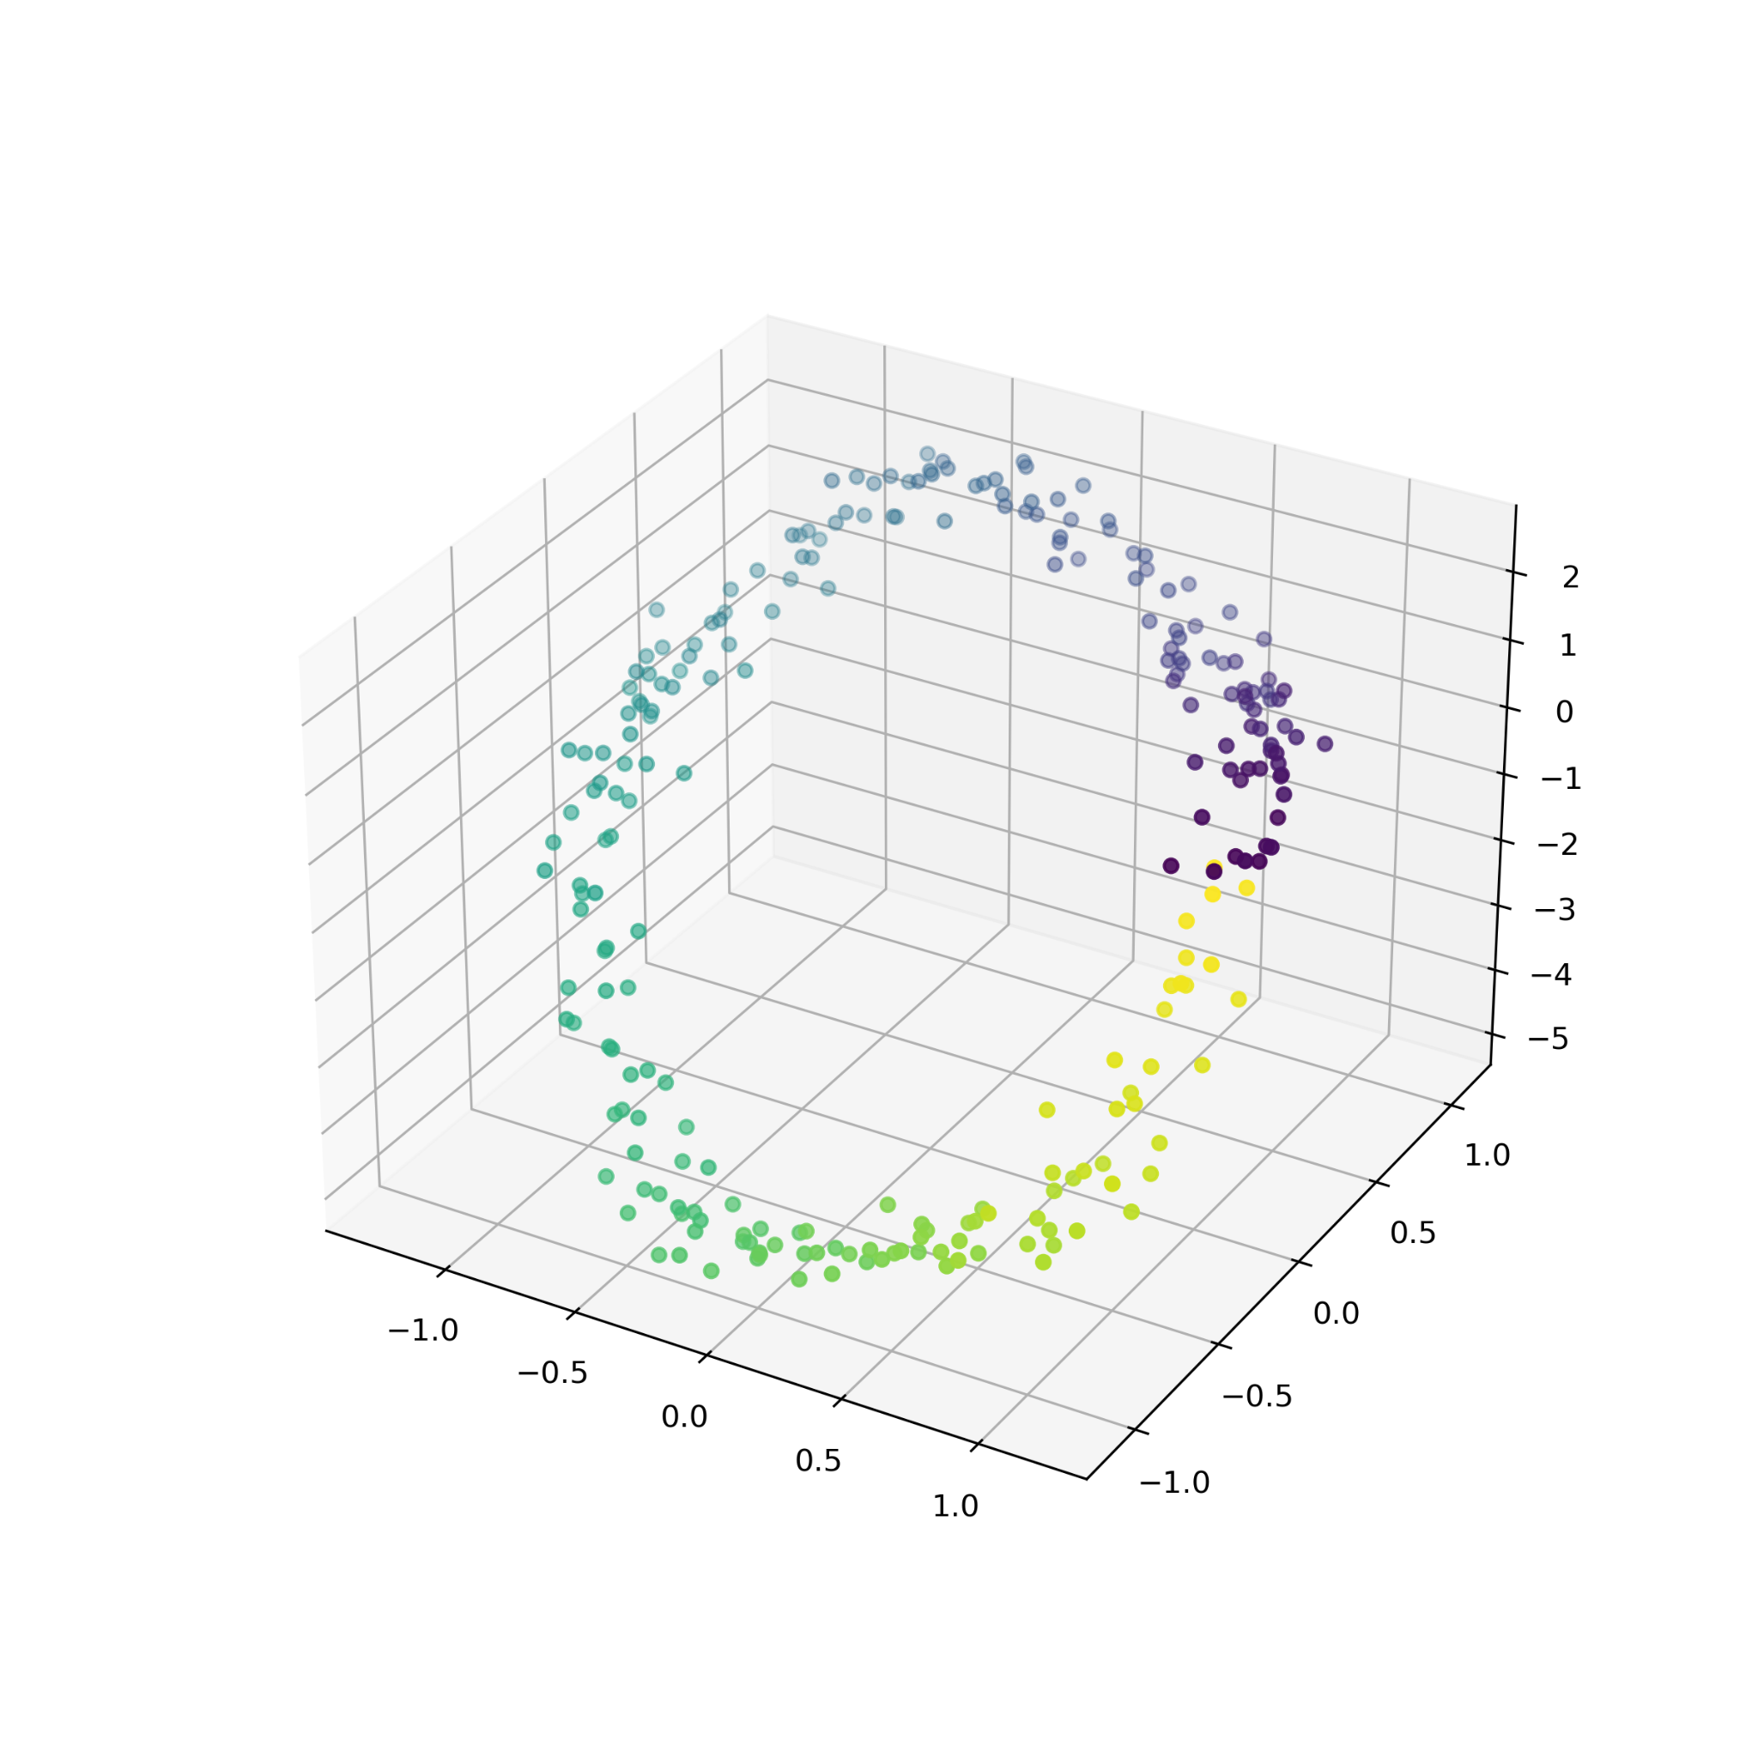
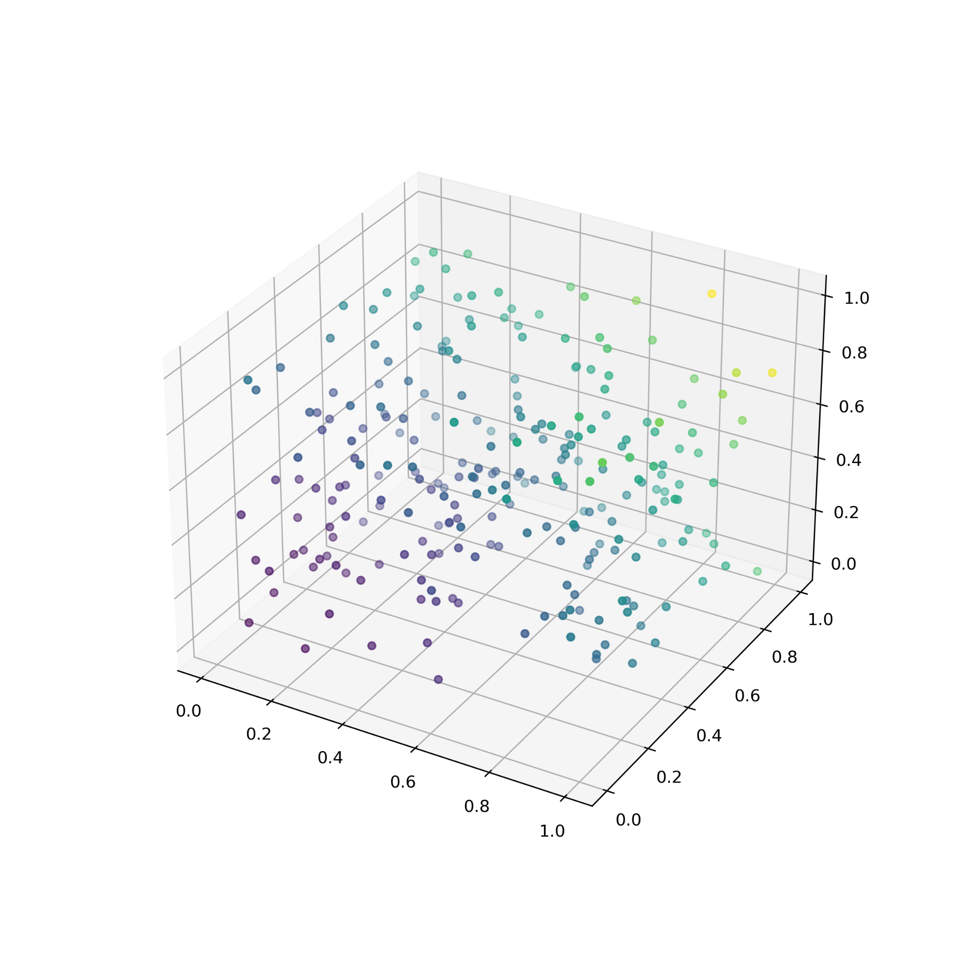
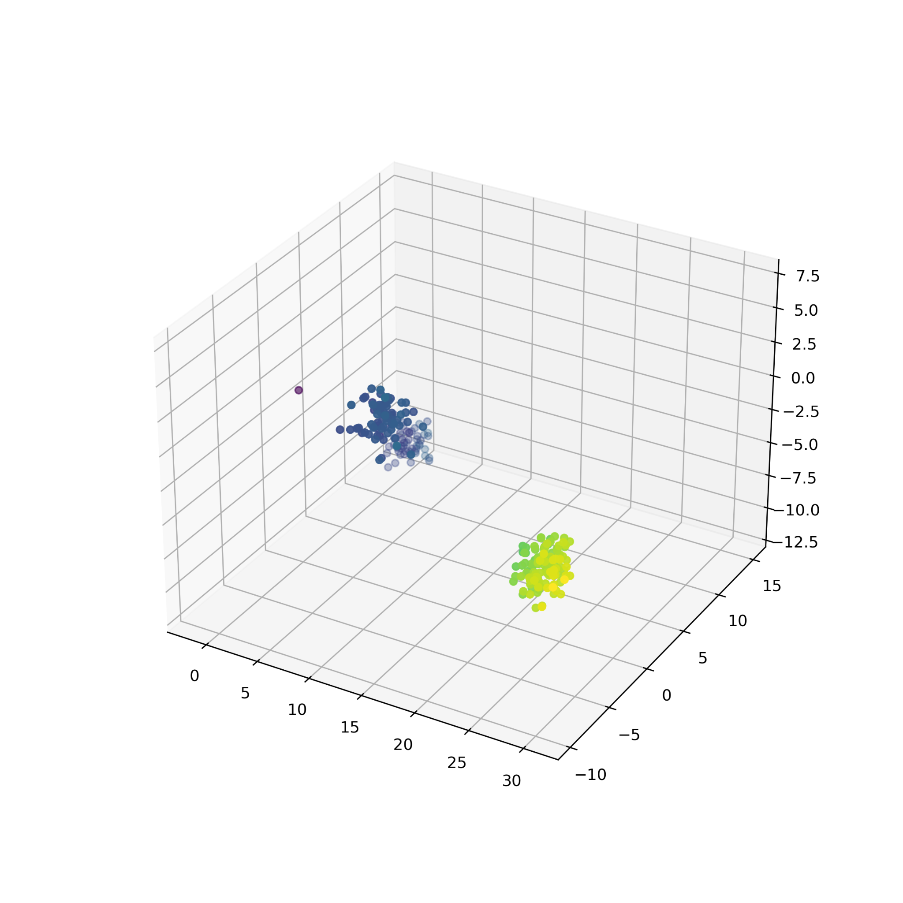
The graph Laplacian in practice -- graphs with weights
“Geometric graphs” (distances in a point cloud)

Slide 17
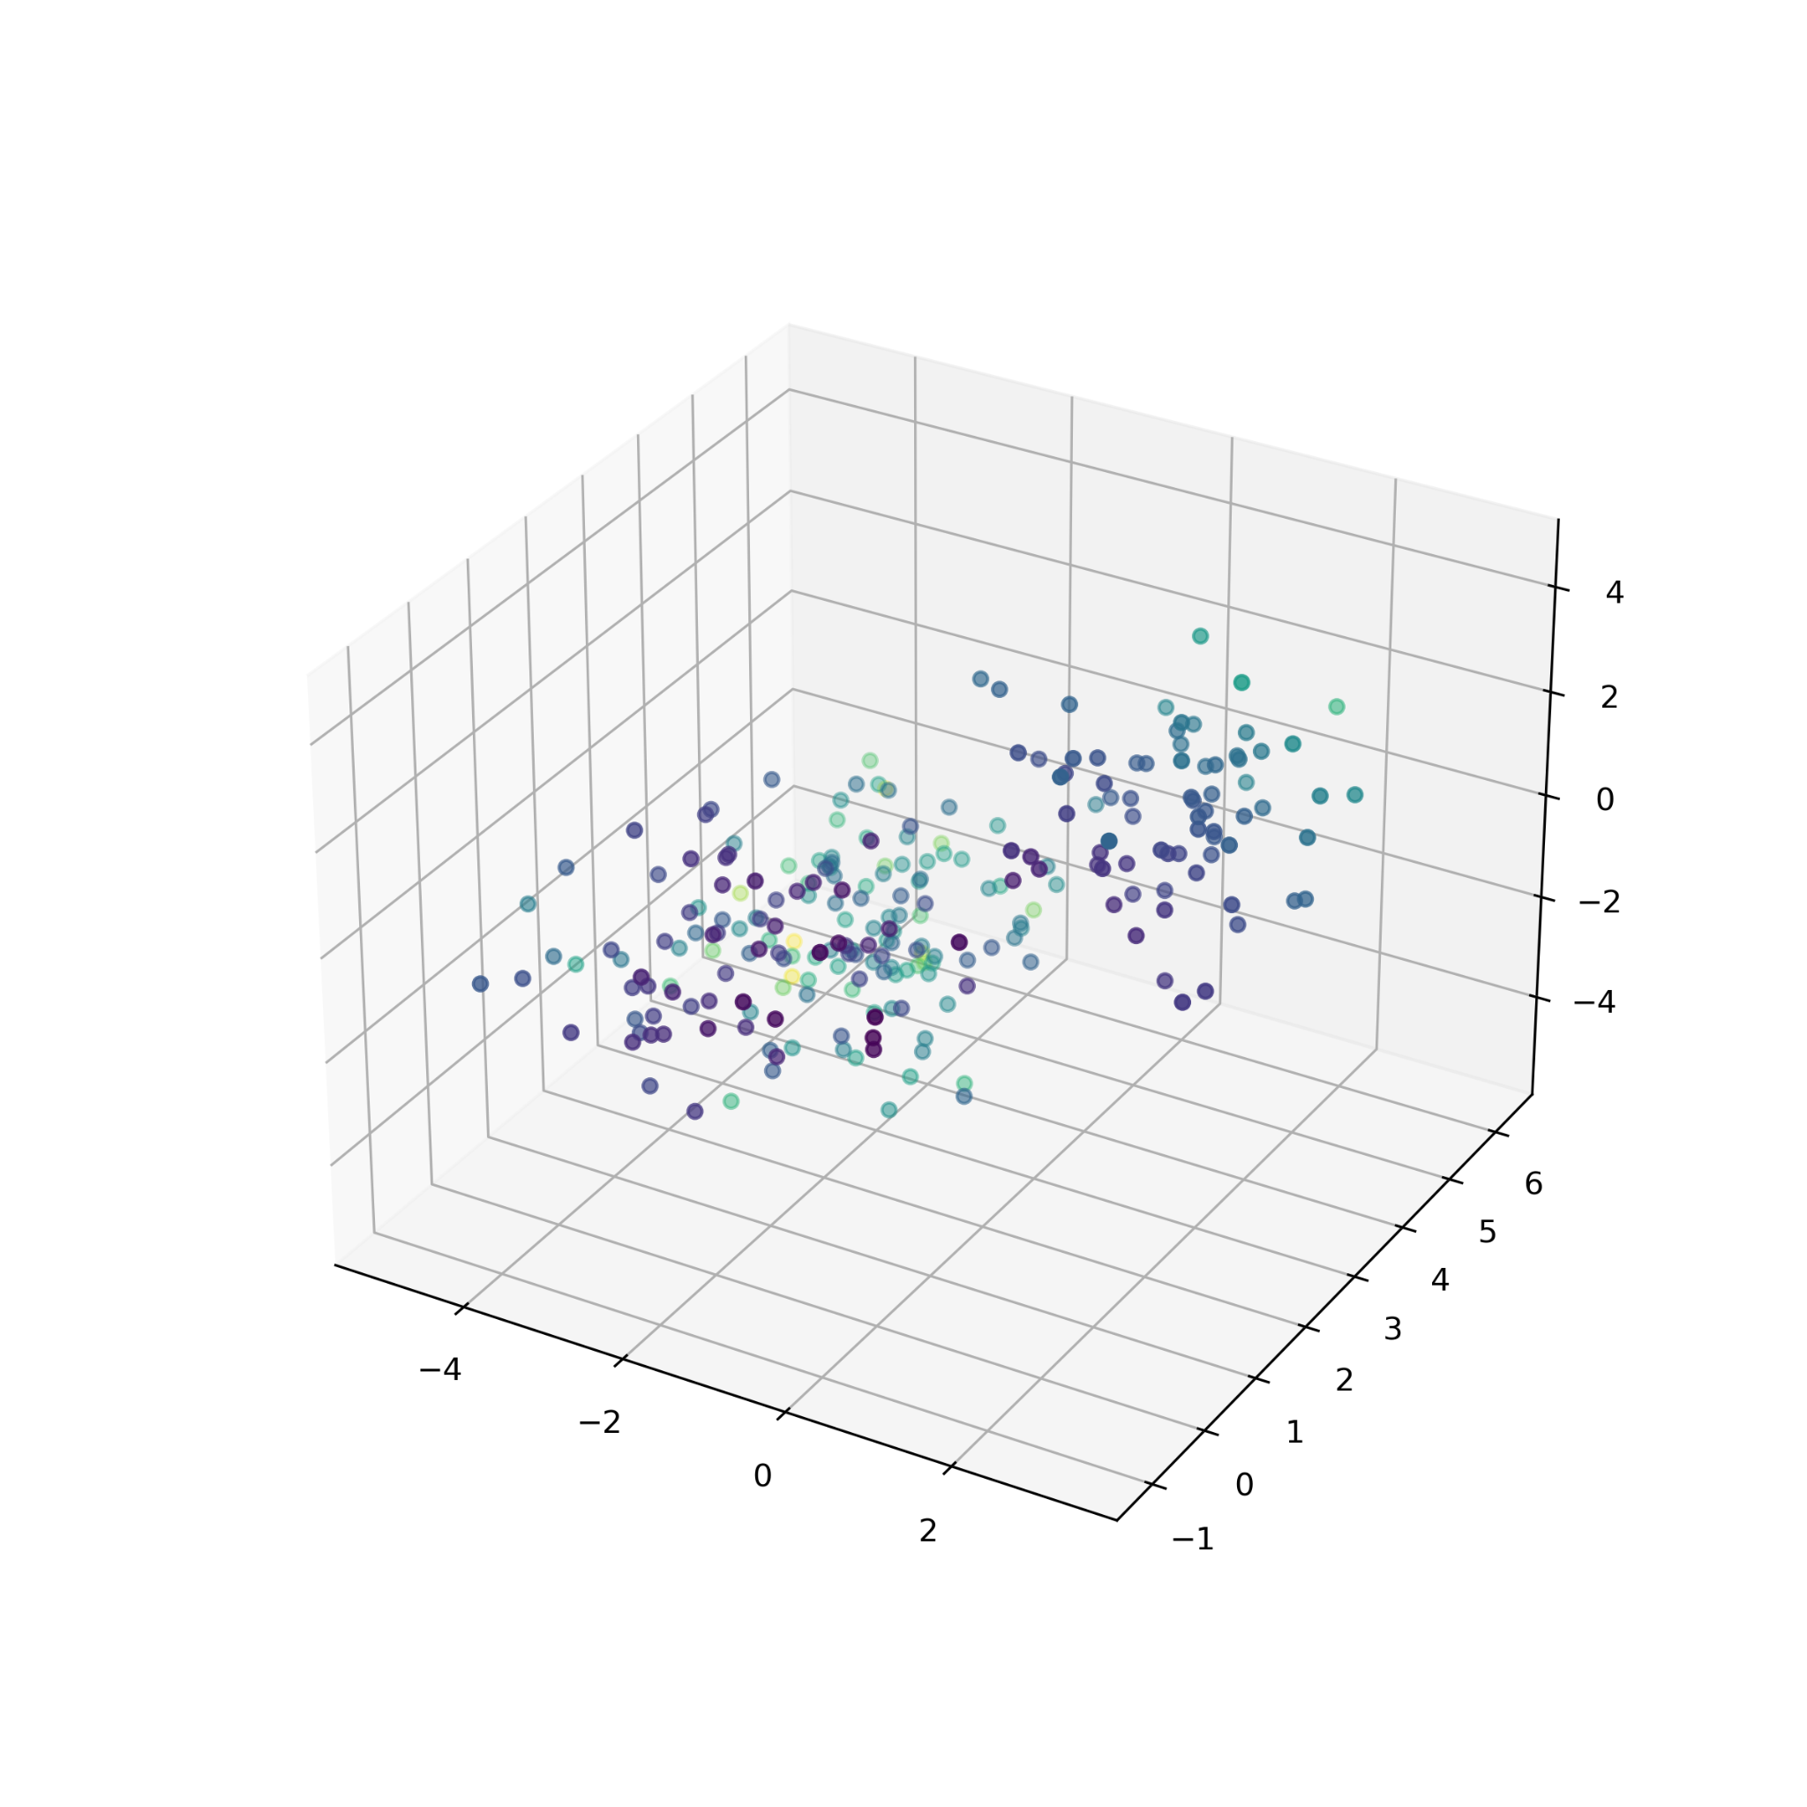
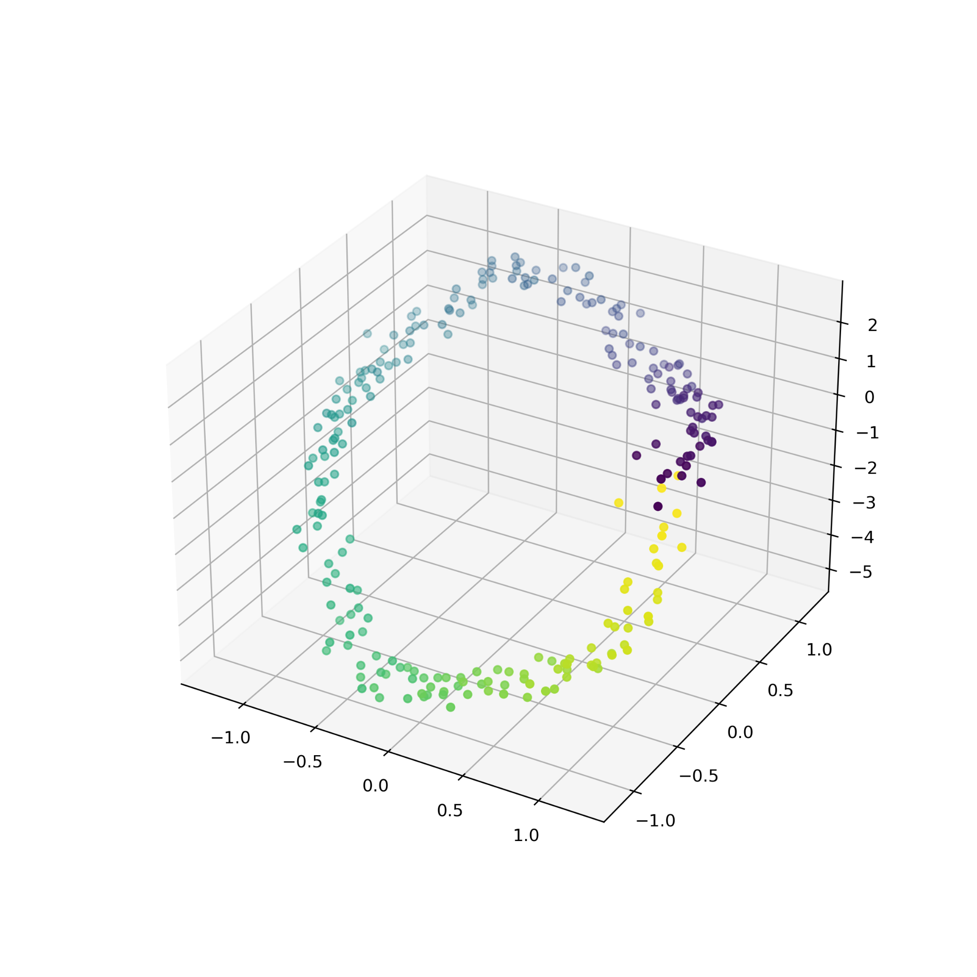
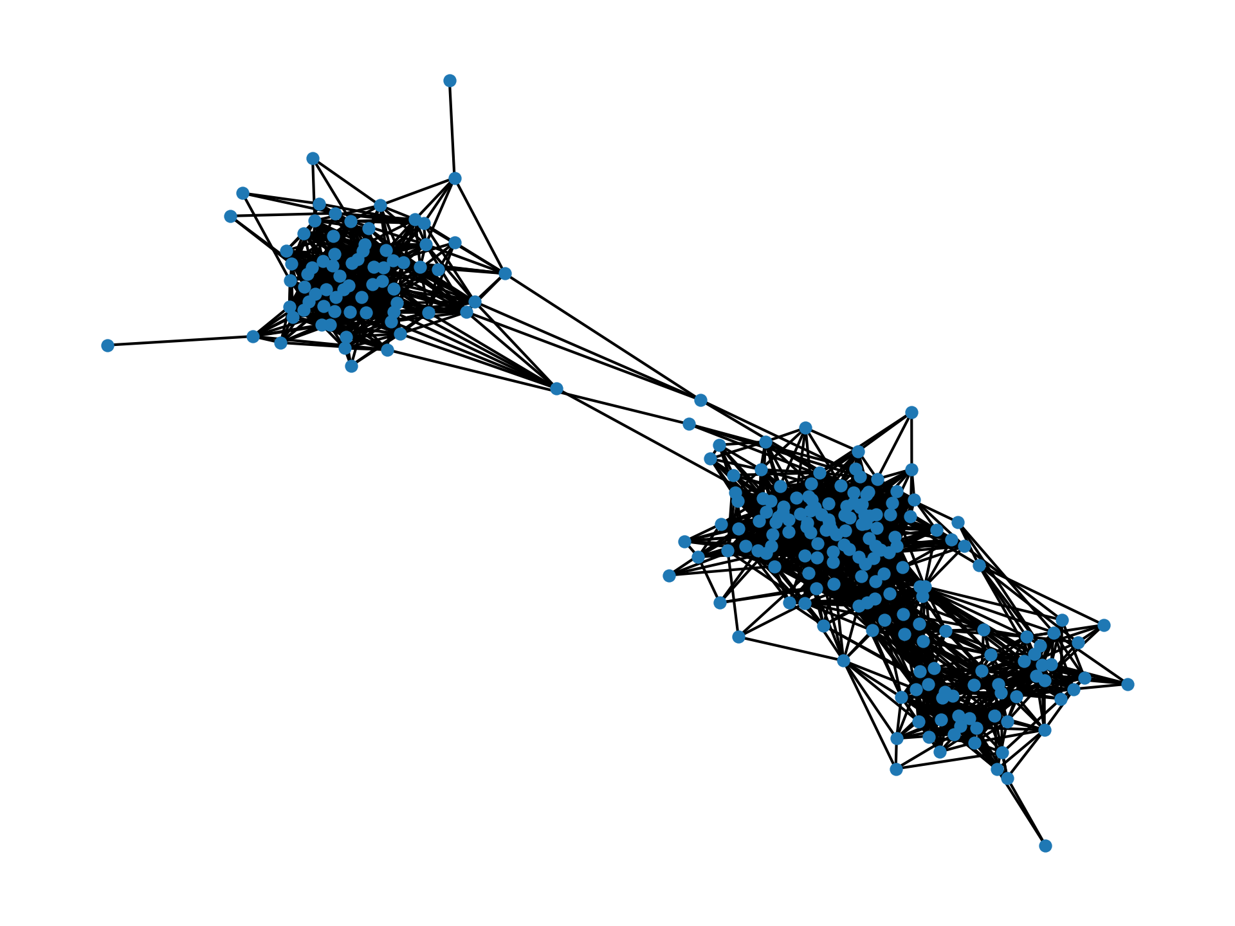
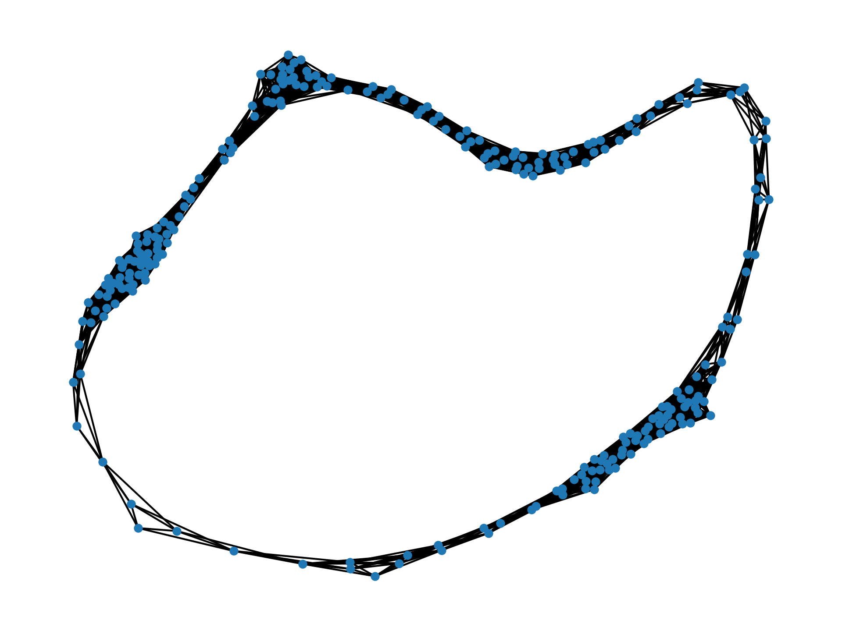
Beyond clusters: generalizing the incidence matrix
But what if our data has structure organized into something other than clusters?
“cluster”
graph
“loop”
graph

Slide 18
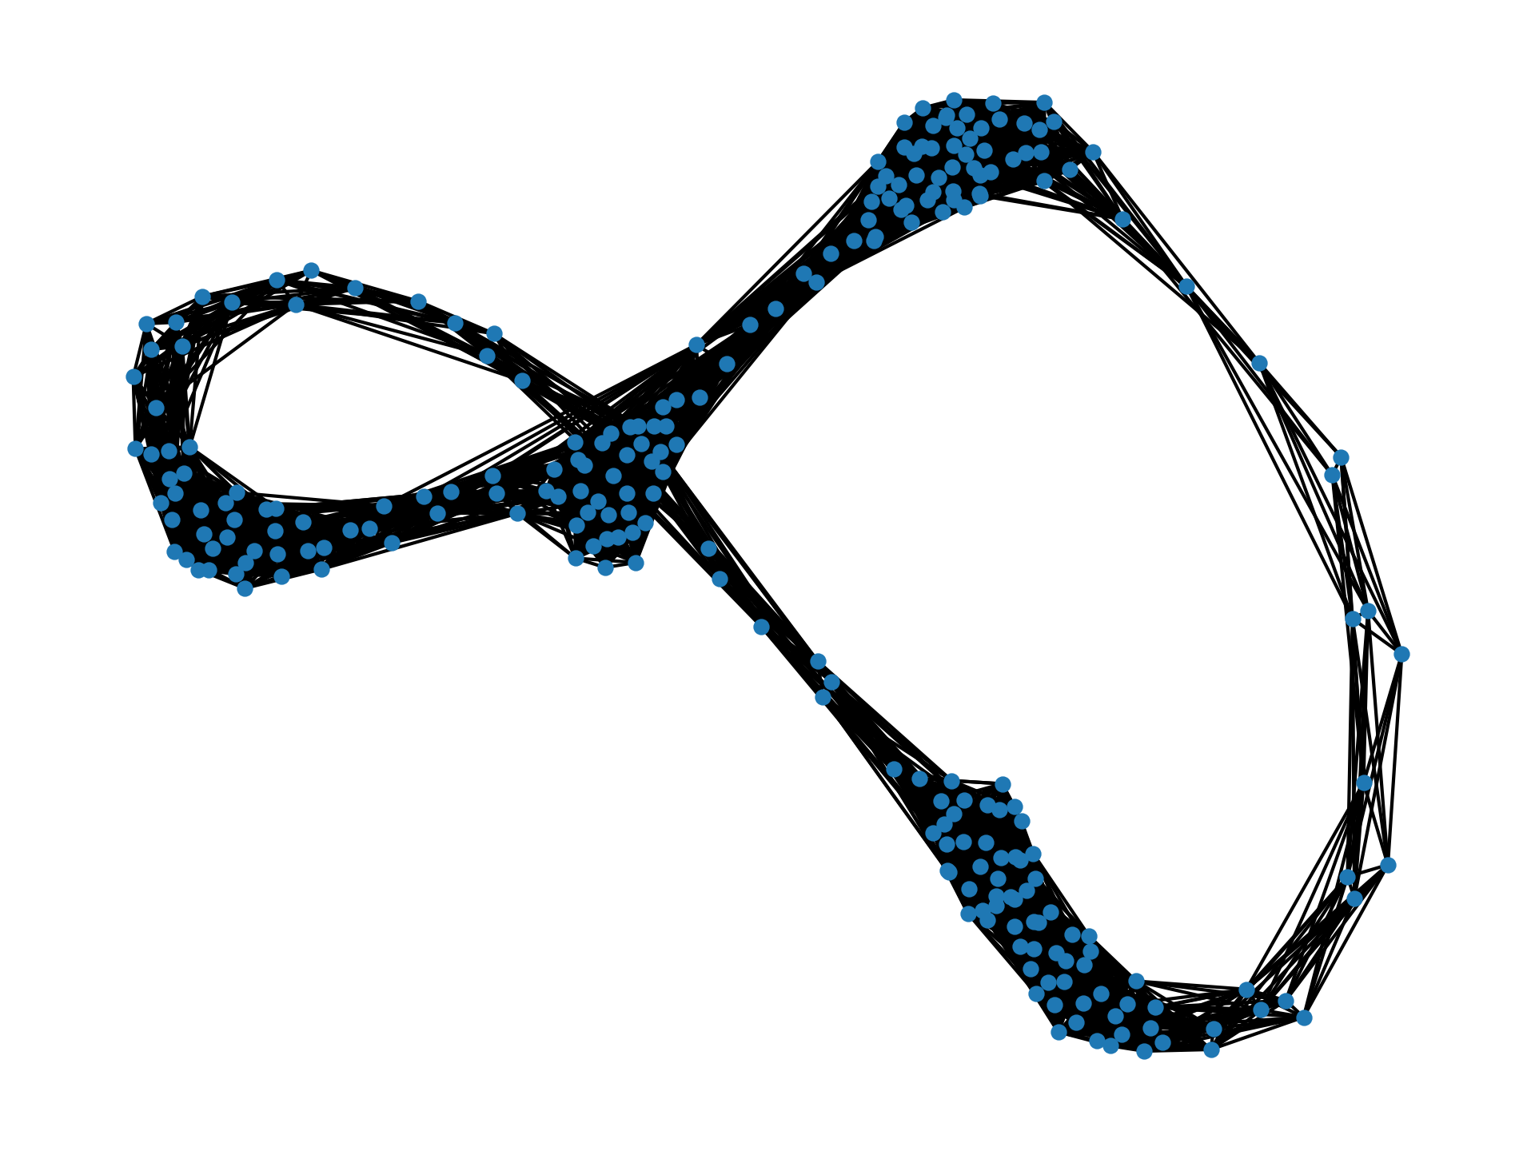
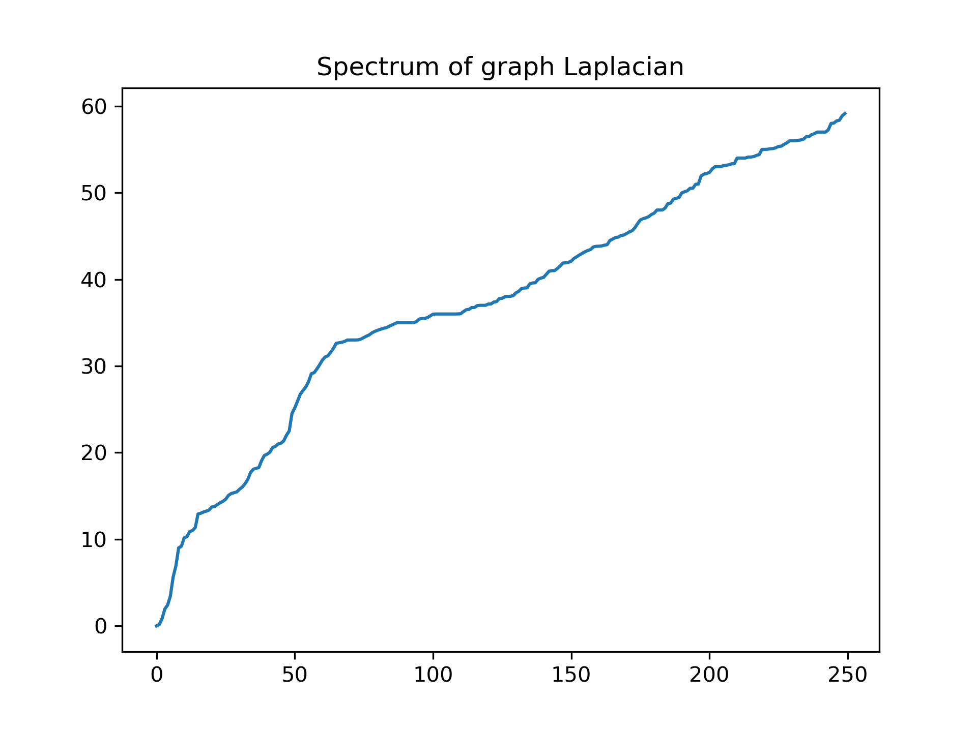
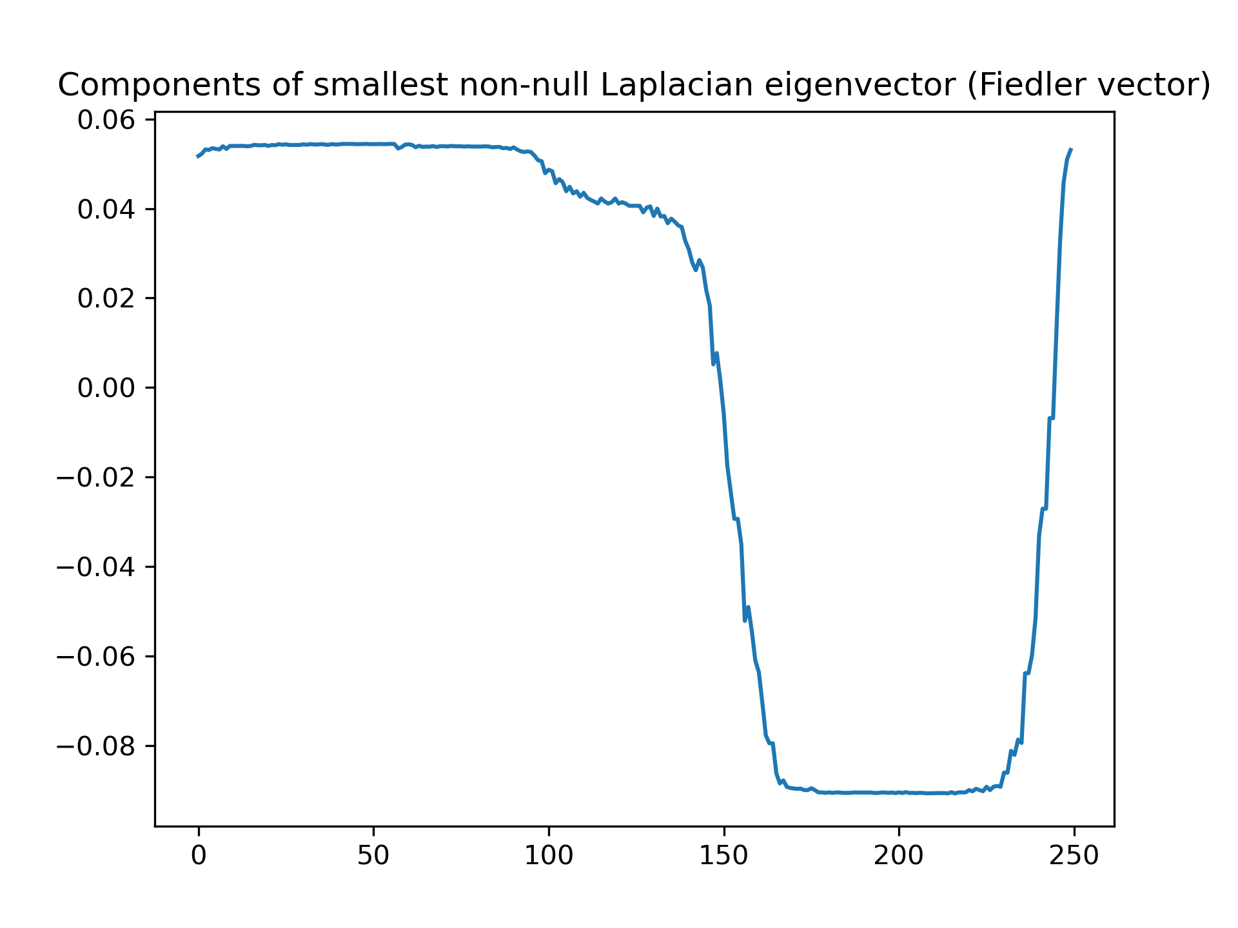
Beyond clusters: revisiting the incidence matrix
The different structures of each of these graphs must be fully captured in the Laplacian matrix! But how can we see it in their corresponding eigenspectra?

Slide 19
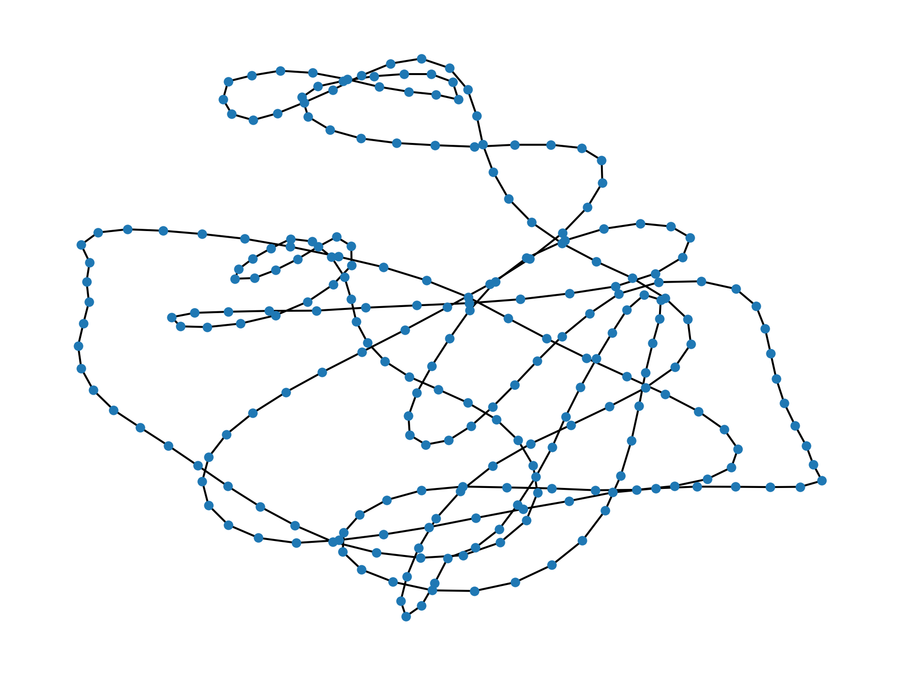
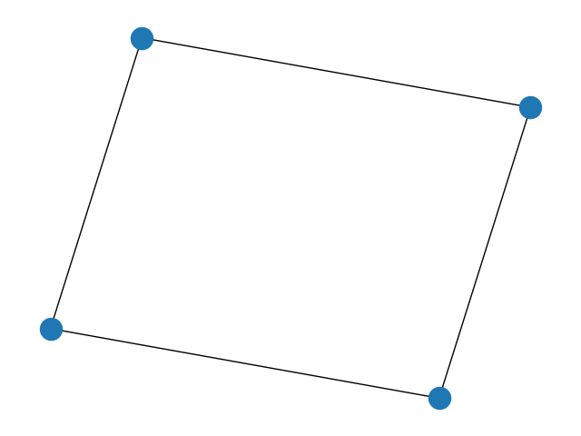
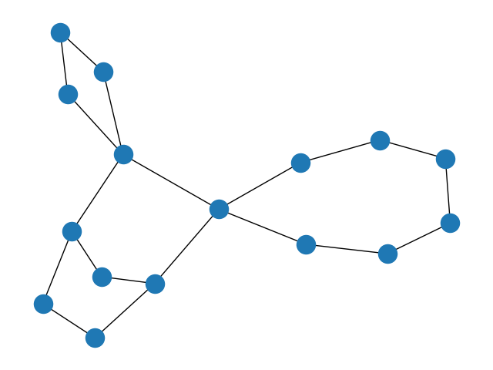
Beyond clusters: revisiting the incidence matrix
The spectra and eigenvectors and certainly different… but could we tell that we’re looking at a loop in the second graph if we only had its spectrum?

Slide 20
Beyond clusters: revisiting the incidence matrix
Let’s revisit this example from earlier! Is this matrix full rank?
If not, how large is its null space?
Edge basis
1 null dimension ⇔ 1 cycle!
Incidence
Vertex basis
Matrix
G = (V,E)
S ~ |V|✕|E| matrix

Slide 21
Beyond clusters: revisiting the incidence matrix
The number of independent cycles in the graph is equal to the dimension of the null space of the incidence matrix! Computing dim(null(S(G)), we get:
1 cycle
1 cycle
3 cycles

Slide 22
Beyond clusters: revisiting the incidence matrix
Great! So does this technique allow us to see our “noisy” loop for what it is?
4420 (?!)
cycles
Apparently not…
we need a way to decide which cycles “count” -- but that’s an algebra story for another time!!
“noisy” cycles

Slide 23
From clusters and loops to SHAPES
0-dimensional structure
These techniques apply to shapes embedded in very high-dimensional spaces: hundreds to hundreds of millions!
Though they do get more complicated, their base is the same: Linear Algebra!
1-dimensional structure
.
.
.
With more effort, we can build linear operators that detect the presence of even higher-dimensional structures!

Slide 24
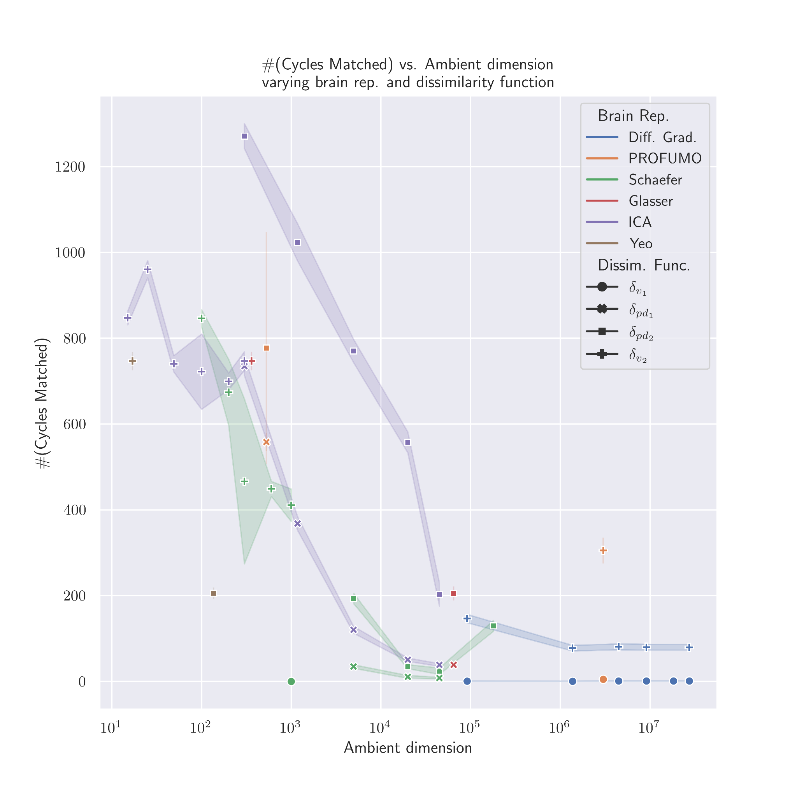
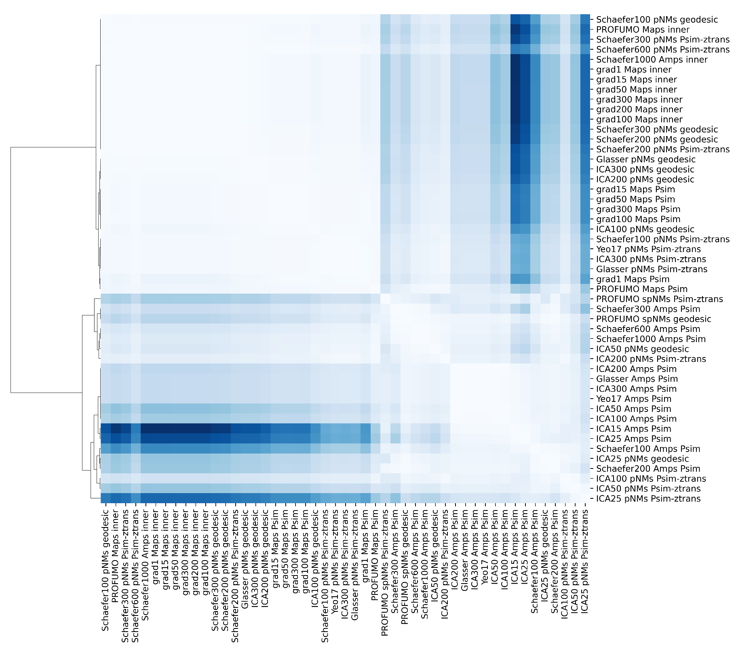
Applications -- comparing brain embeddings!

Slide 25
Thank You!!!

